Slide 1
Digital Image Processing
Jay Prakash Singh
Assistant Professor,
Poornima College of Engineering, Jaipur, Rajasthan

Slide 2
What is Digital Image Processing
Digital Image Processing is concerned with acquiring and processing of an image by means of a digital computer.
technically an image is a two-dimensional light intensity function.
In other words it is a data intensity values arranged in a two-dimensional form like an array, the required property of an image can be extracted from processing an image.
Image processing is a method that performs the analysis and manipulation of digitized images, to improve the quality of image. Adaptability, recurrence and precision in the original data preservation, are the principle advantages of digital image processing methods

Slide 3
Application of Image Processing
Automatic Character Recognition
Military recognition
Automatic processing of fingerprints
Screening of X-ray and blood samples
Machine processing of aerial and satellite imagery for weather prediction
Traffic sensing
Robotics
Medical Fields
Graphics and Animation

Slide 4
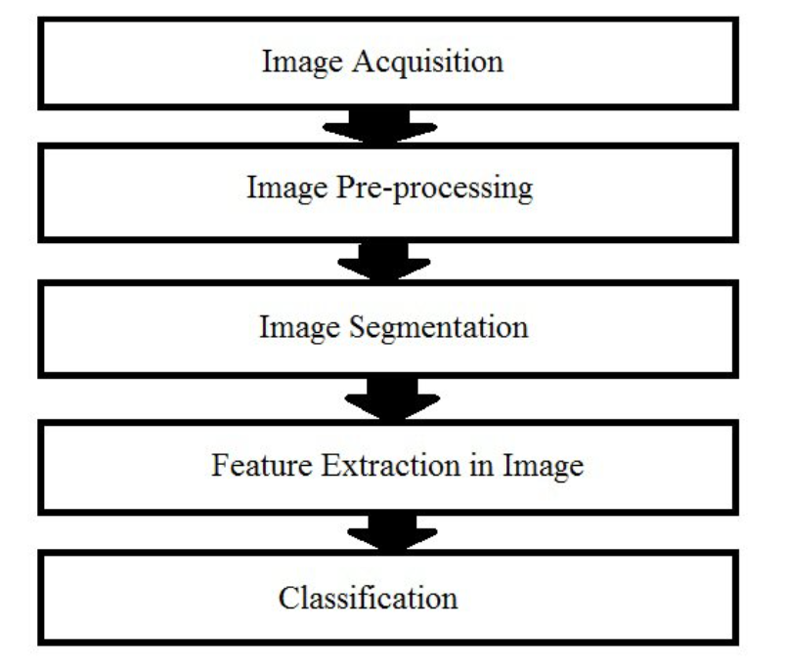
Image Processing Techniques

Slide 5
Image Processing Techniques
Various Image Processing techniques are-
mage Acquisition
Image Preprocessing
Image Enhancement
Image Restoration
Morphological Processing
Image Segmentation
Object Recognition
Image Data Compression

Slide 6
Image Processing Techniques
Some image processing technique takes image as both input and output. Some other techniques will take images as input but attributes of images as output. All these techniques are not required at a time for the processing of images. The selection of techniques are application specific.

Slide 7
Image Processing Techniques
Image Acquisition
An image can be defined as a two-dimensional function, f(u, v), where u and v are plane coordinates, and the amplitude of f at any pair of coordinates (u, v) is called the intensity or gray level of the image at that point.
We can call an image as digital image, when u, v and the amplitude values of f are all finite, discrete quantities .
Image acquisition plays a major role in image processing, since if the images are not acquired properly the various image processing techniques may not be much effective, even with the presence of various enhancement techniques.

Slide 8
Image Processing Techniques
Image Preprocessing
A fundamental step in image processing and computer vision is image preprocessing. The aim of image preprocessing is the improvement of image data by enhancing some features while suppressing some unwanted distortions. Enhancing the features depends on specific applications
Image preprocessing also includes primitive operations to reduce noise, contrast enhancement, image smoothing and sharpening, and advanced operations such as image segmentation.

Slide 9
Image Processing Techniques
Image Enhancement
A fundamental step in image processing and computer vision is image preprocessing. The aim of image preprocessing is the improvement of image data by enhancing some features while suppressing some unwanted distortions. Enhancing the features depends on specific applications
Image preprocessing also includes primitive operations to reduce noise, contrast enhancement, image smoothing and sharpening, and advanced operations such as image segmentation.

Slide 10
Image Processing Techniques
Image Enhancement
The images captured from some conventional digital cameras and satellite images may lack in contrast and brightness, because of the limitations of imaging subsystems and illumination conditions while capturing an image. Image enhancement is one of the simplest and alluring technique to overcome this difficulty.
Some of the image enhancement techniques are: i) Contrast Stretching ii) Noise Filtering iii) Histogram Modification

Slide 11
Image Processing Techniques
Image Restoration
The process of recovering degraded or corrupted image by removing the noise or blur, to improve the appearance of the image is called image restoration. The degraded image is the convolution of the original image, degraded function, and additive noise. Restoration of the image is done with the help of prior knowledge of the noise or the disturbance that causes the degradation in the image.

Slide 12
Image Processing Techniques
Morphological Processing
Morphological processing is a collection of linear operations that is used for extracting image components that are useful in the representation and description of shape. Structuring element is a small set to probe an image under study. Structuring element is compared with the corresponding neighborhood of pixels by positioning it, at all possible locations in the image.

Slide 13
Image Processing Techniques
Image Segmentation
Image Segmentation is the process of partitioning a digital image into multiple segments, to simplify and/or change the representation of an image into something that is more meaningful and easier to analyze. It may make use of statistical classification, thresholding , edge detection, region detection, or any combination of these techniques.
The edge-based techniques rely on discontinuities in image values between distinct regions, and the goal of the segmentation algorithm is to accurately demarcate the boundary separating these regions

Slide 14
Image Processing Techniques
Object Recognition
Object Recognition is the process that provides a label to an object in a digital image or video ,based on its descriptors.eg:-vehicle. Object recognition deals with training the computer to identify a particular object from various perspectives, in various lighting conditions, and with various backgrounds.
Due to scene clutter, photometric effects, changes in shape and viewpoints of the object, the appearance of an object can be varied. It has wide applications in the field of monitoring and surveillance, robot localization and navigation, medical analysis etc.

Slide 15
Image Processing Techniques
Image Data Compression
Compression, as the name implies, deals with techniques for reducing the storage required to save an image, or the bandwidth required to transmit it, without degrading the quality of an image to an unacceptable level. Compression allows to store more images in a given amount disk or memory space.
Compression techniques can be of two types:-lossy and lossless compression.
Lossless compression is preferred for archival purposes and often for medical imaging, technical drawings, clip art, or comics

Slide 16
Image Processing Techniques
Conclusion
Digital image processing has found its utility not only in the field of computer science but also in other domains of Engineering and Technology. This paper gives a comprehensive overview of different image processing techniques and its various applications.

